Slide 1
Economics Case Study On The Product ‘Kayam Churna’ Changes In Demand/Prices Over Time
Group 10:
Yash Patel (131063)
Aatman Dholakia (1401013)
Neel Puniwala (1401024)
Chintan Saraviya (1401026)
Raj Derasari (1401029)
Parth Satodiya (1401056)
Ravi Patel (1401058)
Charvik Patel (1401079)
Assisted By:
Prof. Rita Sharma
Mentor, Kavi Pandya

Slide 2
Introduction
In this project we try to analyse changes in demand/supply with price for the product ‘Kayam Churna’, and see how it performed after the introduction of ‘Nityam Churna’ by ‘Zandu’ brand.
Study the trend in price change, profit earned, quantity supplied and demanded, changes in the quality of product, over a time period of ~10 years
Economics concepts applied:
Demand Theory
Supply Theory
Price Elasticity of demand
Cross Elasticity of demand

Slide 3
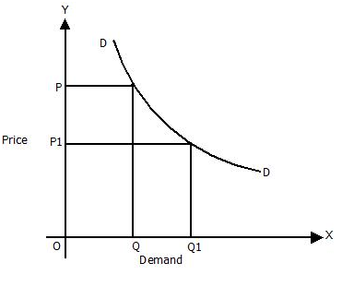
Demand Theory
Law of demand: Keeping other factors constant, the quantity demanded for a product is inversely proportional to the change in the price of the product.
Hence when the price of the product increases there should be a decrease in the quantity demand of the product
It can be represented by a graph similar to:
We observe that theoretically, based on the demand theory, if the price increases the demand may linearly, or non-linearly decrease

Slide 4
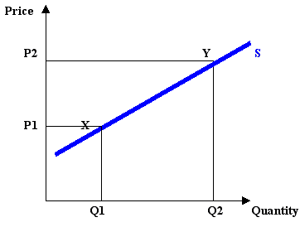
Supply Theory
Law of supply: Keeping other factors constant, the quantity supplied for a product is directly proportional to the change in the price of the product.
Hence when the price of the product increases there should be a increase in the net quantity supply of the product
It can be represented by the graph
We observe that theoretically, based on the supply theory, if the price increases the supply may linearly, or non-linearly increase.

Slide 5
elasticity definitions
To quantify the linear/nonlinear increase/decrease in supply theory or demand theory respectively, we use the concept of elasticity.
There are three concepts of elasticity:
Price Elasticity of a product
Income Elasticity of a product
Cross Elasticity between two products

Slide 6
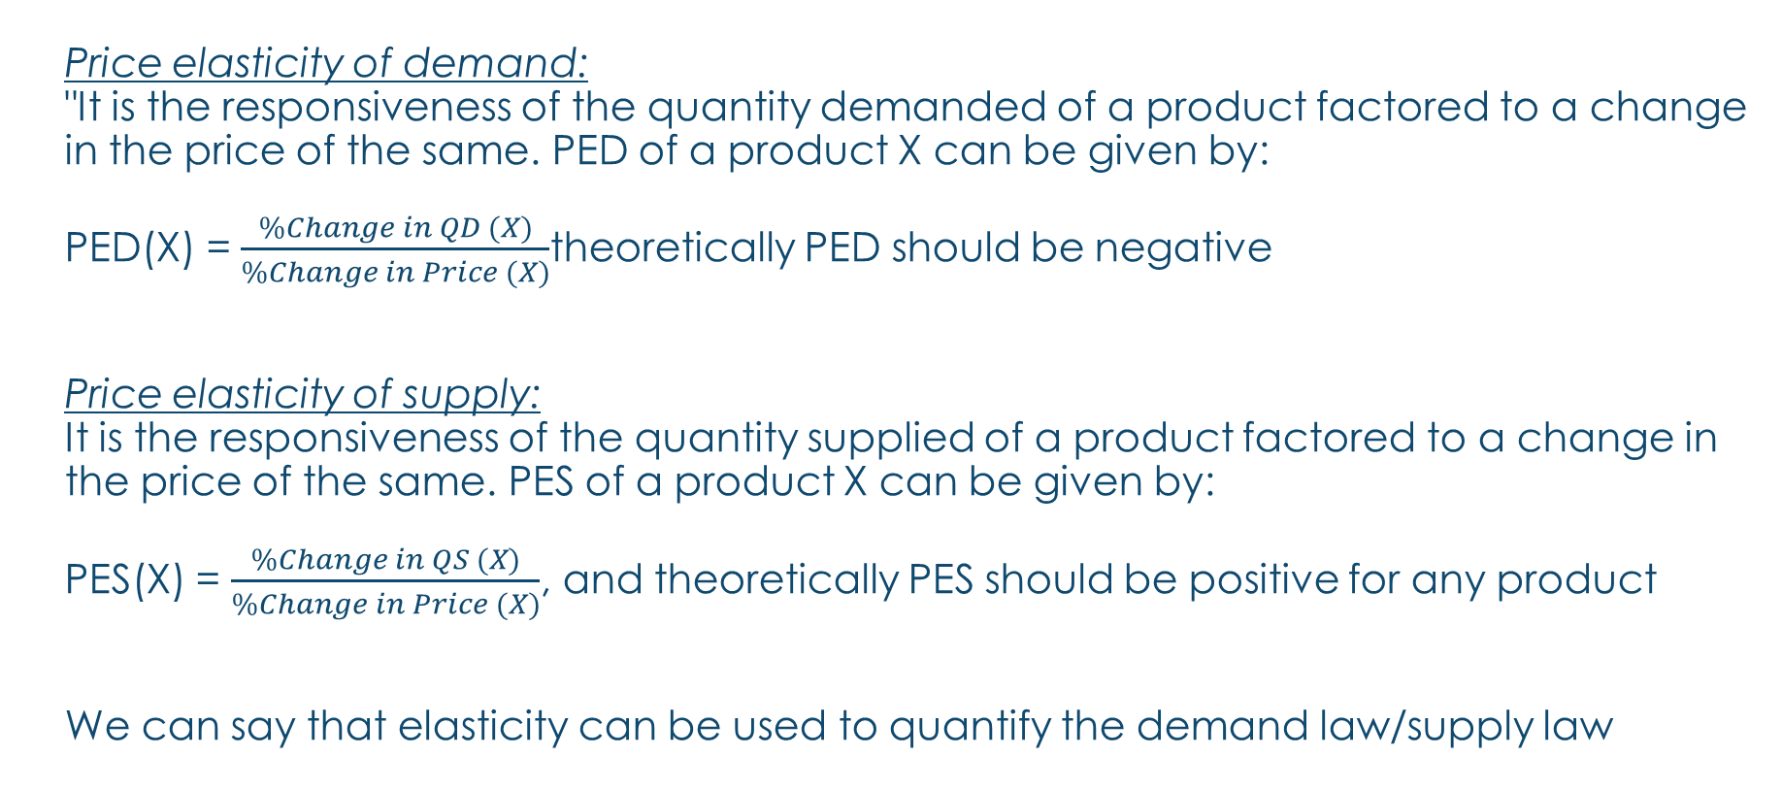
Price Elasticity definition
Price elasticity of demand: "It is the responsiveness of the quantity demanded of a product factored to a change in the price of the same. PED of a product X can be given by: PED(X) = $\frac{\%Change in QD (X)}{\%Change in Price (X)}$theoretically PED should be negative
Price elasticity of supply: It is the responsiveness of the quantity supplied of a product factored to a change in the price of the same. PES of a product X can be given by: PES(X) = $\frac{\%Change in QS (X)}{\%Change in Price (X)}$, and theoretically PES should be positive for any product
We can say that elasticity can be used to quantify the demand law/supply law

Slide 7
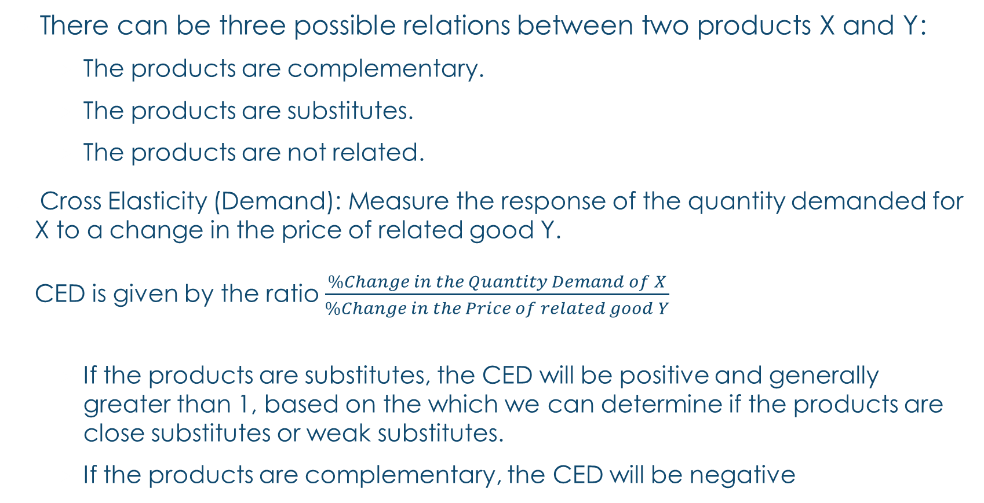
Cross elasticity DEFINITION
There can be three possible relations between two products X and Y:
The products are complementary.
The products are substitutes.
The products are not related.
Cross Elasticity (Demand): Measure the response of the quantity demanded for X to a change in the price of related good Y. CED is given by the ratio $\frac{\%Change in the Quantity Demand of X}{\%Change in the Price of related good Y}$
If the products are substitutes, the CED will be positive and generally greater than 1, based on the which we can determine if the products are close substitutes or weak substitutes.
If the products are complementary, the CED will be negative

Slide 8
OBSERVATIONS: Factors affecting demand/ supply
Well, there isn’t a large variety of factors affecting the demand of ‘churna’. The main factors that affect the demand for this product are:
Price of the product for the given amount/weight (customer satisfaction)
Population, awareness of the existence of the product (advertisement)
Brand value / what the population thinks of the brand
Quality of the product provided / product reputation
Existence of substitutes / competing brands
Factors affecting supply of the product:
Production cost
Demand
Profit margin (based on the above two factors)

Slide 9
Observations: Notes REGARDING SALES
‘Kayam Churna’
Introduced in 2005, price 50/- for 120gms box, 20% profit margin
Between 2005 and 2010 price increases upto ~60/- per box
Substitute products are introduced, and competition increases
As inflation rates increase (around 2009), the weight per box is brought down to 100gms for the same price to decrease the production cost, maintaining a reasonable profit rate “to stay alive”
Gradually, its market is stabilized by more advertising and promotion of the product, and at the latest (2015) a 100gms box costs Rs. 65/-, up from the cost of Rs.60/- per box in 2013.

Slide 10
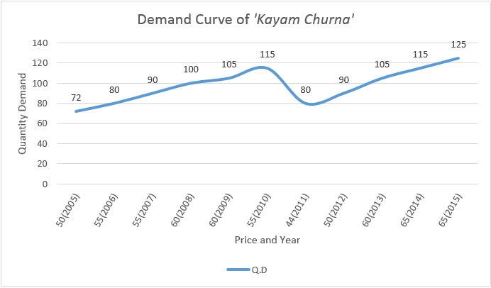
Graph from Observations and Notes
‘Kayam Churna‘
As the average price increased over a period of 10 years, the demand actually increases instead of decreasing:
In 2010 average price was Rs. 60/- but due to increasing popularity of ‘Kayam Churna’ in the market the demand increases, contrary to theoretical expectation
In 2011 new products introduced, demand decreases even though price decreases (to Rs. 45/-)
Since then, sales gradually recover by more advertisement and promotion, and although gradually prices increase (to Rs. 65/-) the demand also increases.
Positive price elasticity is observed during most of the price changes

Slide 11
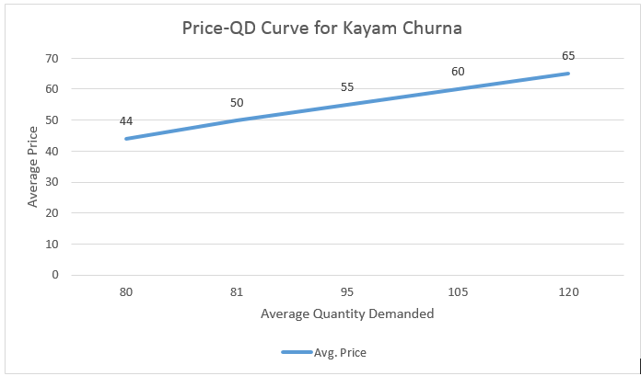
Price-QD curve, BASED ON DEMAND theory
Again, despite theoretical expectation of the price increase leading to a demand decrease, we observed that the demand gradually increases or stays nearly constant for all price changes
Starting price, Rs. 44, was the introductory price
Last known price was Rs. 65 as of 2015 December.

Slide 12
Observations: competitive product brings a Change in the trend
Zandu Nitya Churna
Introduced later, in 2011, at an introductory price tag of Rs. 40/- for 100gms box, at ~15% profit margin. It was in direct competition against Kayam Churna
Prices steadily increase with time, but due to average income increase in the population and such, sales do not decline, but rather, grow marginally, due to the increasing popularity of the product with good brand value.
The product market has been mostly stable, there have been no major upsets in the trends since its introduction. At the end of 2015 it costs Rs. 54/100gms.

Slide 13
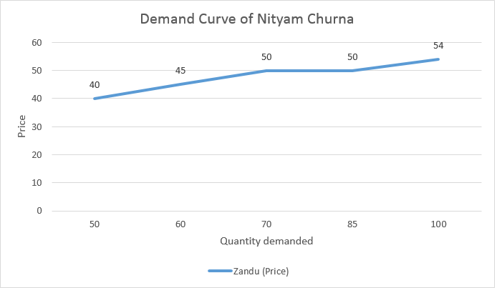
OBSERVED DEMAND CURVE
‘Nityam Churna‘
This graph presents the representative data for sales of ‘Nityam Churna’ over 2011 to 2015.
So far it has an almost stable price, with no change in quality/quantity of the product, and demand has been gradually increasing lead by the promotion and advertisement of the product, and because of high brand value for ‘Zandu’

Slide 14
Observations and Notes
Relatively new brands of ‘churna’:
Patanjali brand has been around for a long time, but only recently has it started getting fame and recognition, increasing its brand value. They have released a range of ‘churna’, all within the range of Rs.35 to Rs.50 per box (all 100gms). Only as time passes, we may be able to tell how this impacts the products of the other two brands.
Kranti pharmaceuticals, (inception in 2008) have recently released their brand of ‘churna’, expected to be @Rs.40 per 100gms box, and upto Rs.150 per 400gms. The brand is relatively unknown but as the popularity increases, there should be a positive change in quantity demand

Slide 15
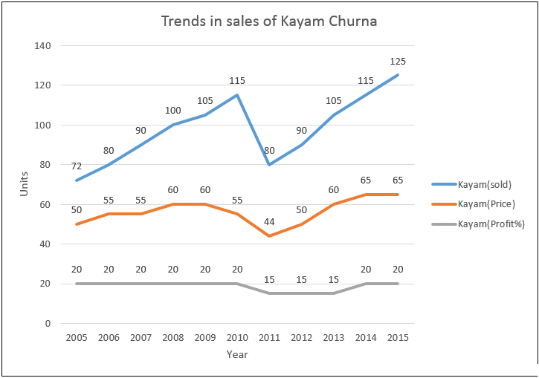
Observed Trends: Kayam/Nityam Churna
Notes:
Zandu trends begin from 2011
Kayam prices decrease in 2009-2010, following recession, to maintain profit margin they reduce weight per box from 120gms to 100gms
After stabilising the quantity demand and price gradually increase
Price values are in Rs.,and Quantity demanded are in units/month

Slide 16
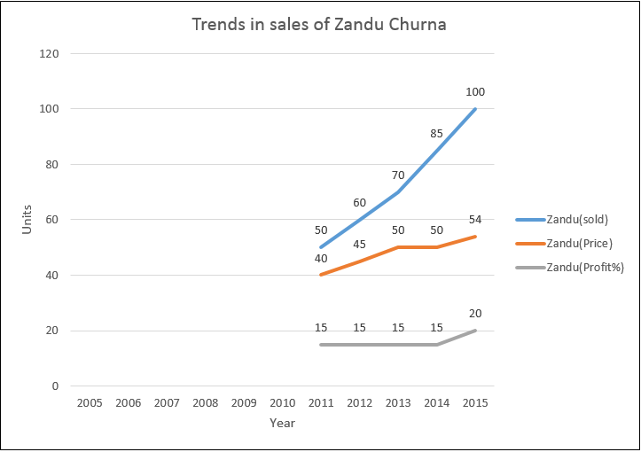
Observed Trends: Kayam/Nityam Churna
Notes:
Zandu trends begin from 2011
Kayam prices decrease in 2009-2010, following recession, to maintain profit margin they reduce weight per box from 120gms to 100gms
After stabilising the quantity demand and price gradually increase
Price values are in Rs.,and Quantity demanded are in units/month

Slide 17
OBSERVATIONS: Elasticity under given conditions
Kayam Churna
Nityam Churna
Price/Yr | Qd/Yr
Rs.44(2011) | 80
Rs.50(2012) | 90
Rs.50(2013) | 105
Rs.60(2014) | 115
Rs.65(2015) | 125
Price/Yr | Qd/Yr
Rs.50(2011) | 50
Rs.45(2012) | 60
Rs.50(2013) | 70
Rs.50(2014) | 85
Rs.54(2015) | 100

Slide 18
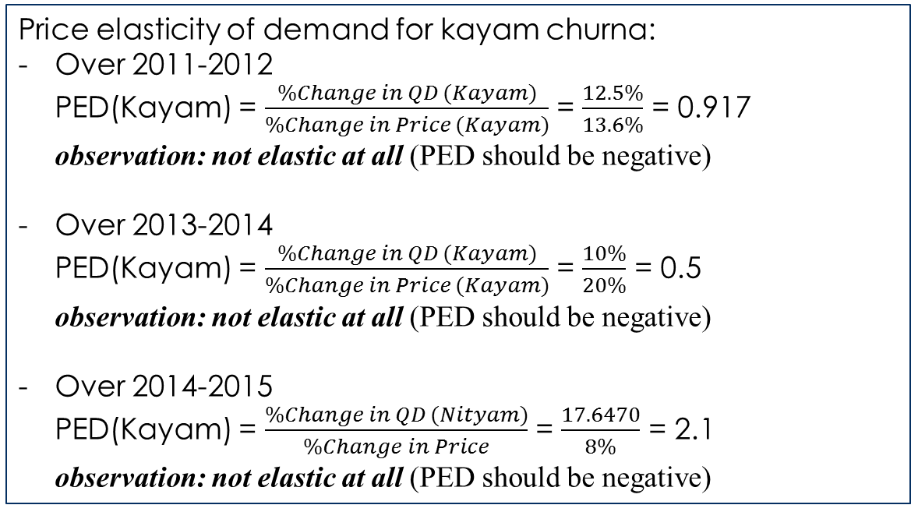
Price elasticity
Kayam Churna
Price/Yr | Qd/Yr
Rs.44(2011) | 80
Rs.50(2012) | 90
Rs.50(2013) | 105
Rs.60(2014) | 115
Rs.65(2015) | 125
Price elasticity of demand for kayam churna:
Over 2011-2012 PED(Kayam) = $\frac{\%Change in QD (Kayam)}{\%Change in Price (Kayam)}$ = $\frac{12.5\%}{13.6\%}$ = 0.917 observation: not elastic at all (PED should be negative)
Over 2013-2014 PED(Kayam) = $\frac{\%Change in QD (Kayam)}{\%Change in Price (Kayam)}$ = $\frac{10\%}{20\%}$ = 0.5 observation: not elastic at all (PED should be negative)
Over 2014-2015 PED(Kayam) = $\frac{\%Change in QD (Nityam)}{\%Change in Price}$ = $\frac{17.6470}{8\%}$ = 2.1 observation: not elastic at all (PED should be negative)

Slide 19
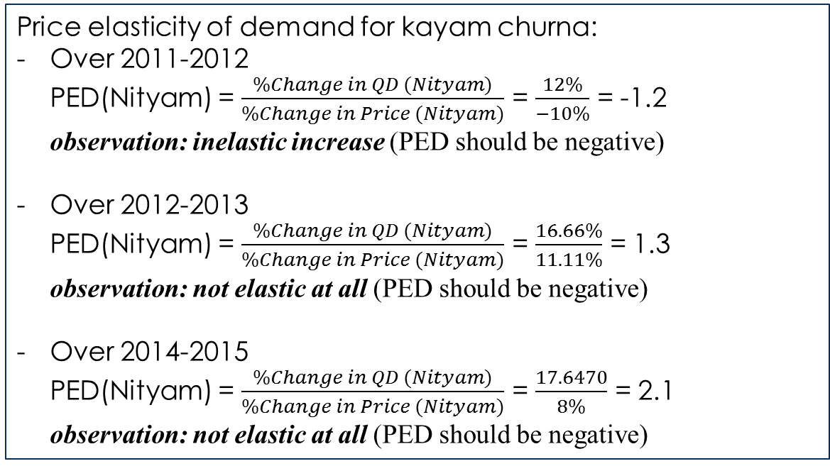
Price elasticity
Nityam Churna
Price/Yr | Qd/Yr
Rs.50(2011) | 50
Rs.45(2012) | 60
Rs.50(2013) | 70
Rs.50(2014) | 85
Rs.54(2015) | 100
Price elasticity of demand for kayam churna:
Over 2011-2012 PED(Nityam) = $\frac{\%Change in QD (Nityam)}{\%Change in Price (Nityam)}$ = $\frac{12\%}{−10\%}$ = -1.2 observation: inelastic increase (PED should be negative)
Over 2012-2013 PED(Nityam) = $\frac{\%Change in QD (Nityam)}{\%Change in Price (Nityam)}$ = $\frac{16.66\%}{11.11\%}$ = 1.3 observation: not elastic at all (PED should be negative)
Over 2014-2015 PED(Nityam) = $\frac{\%Change in QD (Nityam)}{\%Change in Price (Nityam)}$ = $\frac{17.6470}{8\%}$ = 2.1 observation: not elastic at all (PED should be negative)

Slide 20
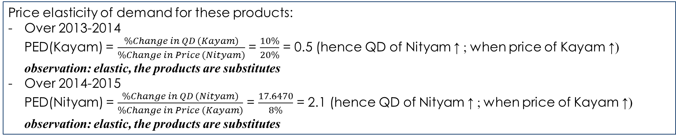
Cross elasticity
Kayam Churna
Nityam Churna
Price/Yr | Qd/Yr
Rs.44(2011) | 80
Rs.50(2012) | 90
Rs.50(2013) | 105
Rs.60(2014) | 115
Rs.65(2015) | 125
Price/Yr | Qd/Yr
Rs.50(2011) | 50
Rs.45(2012) | 60
Rs.50(2013) | 70
Rs.50(2014) | 85
Rs.54(2015) | 100
Price elasticity of demand for these products:
Over 2013-2014 PED(Kayam) = $\frac{\%Change in QD (Kayam)}{\%Change in Price (Nityam)}$ = $\frac{10\%}{20\%}$ = 0.5 (hence QD of Nityam ↑ ; when price of Kayam ↑) observation: elastic, the products are substitutes
Over 2014-2015 PED(Nityam) = $\frac{\%Change in QD (Nityam)}{\%Change in Price (Kayam)}$ = $\frac{17.6470}{8\%}$ = 2.1 (hence QD of Nityam ↑ ; when price of Kayam ↑) observation: elastic, the products are substitutes

Slide 21
Conclusion
In conclusion, we observe that
In real life the products may not usually follow the demand theory or supply theory. Depending on various factors, the price and quantity demand or supply are affected.
Correlation of the price/quantity, with our trivial assumption as “other factors being kept constant” is purely theoretical
Similarly, we also conclude that not every product follows the elasticity theory, from our observations that despite a price rise, demand of product may increase, or it even may decrease.
From the cross elasticity of the two products we were able to determine that they are strong substitutes. (Even from general logic we can presume that a consumer ‘X’ would only be using any one of the two products, whatever their personal preferences are)

Slide 22
References, sources
“Dholakia brothers” pharmacy for representative data in sales figures and cost prices of both products since 2005 to 2015, courtesy of Aatman Dholakia
“Principles of Mircoeconomics”, textbook for various definitions on economics concepts

Slide 23
THANK YOU

